Slide 1

FINAL GROUP PROJECT PRESENTATION
BDAT 1004 Data Programming (S2021) August 19, 2021
Daryoush Shabahang, Dhruval Domadiya and Jay Gajjar GROUP 1

Slide 2

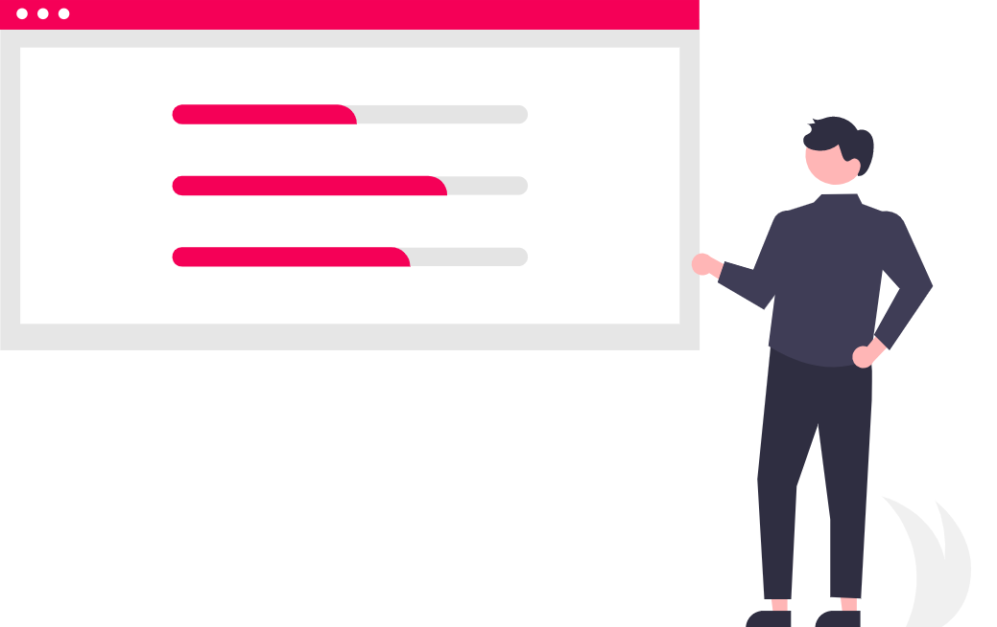
Talking Points
We will be discussing these:
1. Team members
2. Project topic
3. API Data source
4. Project scope
5. Tools used
6. Database storage (MongoDB Atlas)
7. Website design (Flask)
8. Website deployment (Google Cloud)
9. Visualizations (Chart.js)
10. Bonus questions (MongoDB Realm)
11. Postman
12. Fit gap analysis
© 2021 BDAT 1004 Final Group Project

Slide 3


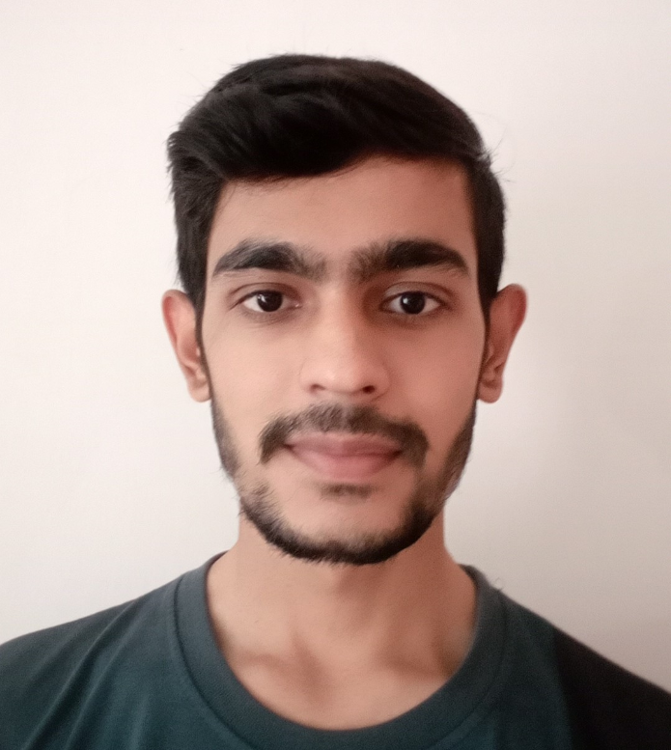
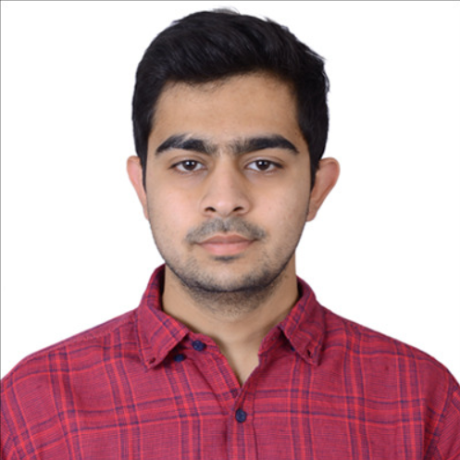
Team Members
Our team members:
Daryoush Shabahang - Developer / Project Manager I have completed my bachelor’s in Communications with a minor in Digital Media, as well as worked at several unique companies and industries throughout the years, including ecommerce and telecommunications.
Dhruval Domadiya - Developer (charts) I have completed my bachelor's in computer engineering in 2020. I worked as an administrator at a private school for one year. I am more interested in management & analytics and want to start my career in the field of sales and marketing as an assistant manager.
Jay Gajjar - Developer (charts) I have graduated in Computer Engineering and worked in a data warehousing company called Saama Technology. I processed Genentech provided data for Healthcare Profession and Healthcare Organization submit it to the Centers for Medicare & Medicaid Services (CMS).
© 2021 BDAT 1004 Final Group Project

Slide 4


Project Topic
A client has asked us to build a proof of concept "Web" application to demonstrate our abilities as a team/company.
They are prepared to contract our team for several years however, they have many other bids to review. This presentation will show them why our team is right for the job.
© 2021 BDAT 1004 Final Group Project

Slide 5
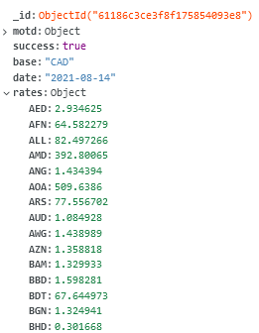
API Data Source
We have decided that our data source will be an API on exchange rates.
The data shows us the base rate which we formatted to display in CAD instead of EUR which is the default base rate. The other columns are the “date” i.e. 2018-08-14 and the various exchange “rates” with other currencies in the world i.e. 1 CAD = 2.93 AED.
Columns:
“_id”
“motd”
“success”
“base”
“date”
“rates”
© 2021 BDAT 1004 Final Group Project

Slide 6

API Data Source
Flask Website
Chart.js
Python & MongoDB
MongoDB Realm
Project Scope
We acquired our data from https://api.exchangerate.host/latest?base=CAD
We created a small website on the Flask framework and deployed it to Google Cloud.
We created a few unique visualizations using Chart.js library and added to our site.
1st Step |  |  |  | 2nd Step | 3rd Step | 4th Step | 5th Step
We used Python code with the API and stored/loaded into MongoDB Atlas (cloud).
We created an API with MongoDB Realm to extract data for the bonus questions.
© 2021 BDAT 1004 Final Group Project

Slide 7

Tools Used
These are the tools, packages/libraries, and programs that we have used for this project:
Python
Flask framework
Pymongo module
Chart.js
Microsoft PowerPoint
MongoDB Atlas
MongoDB Realm
Google Cloud Platform
Google Slides
Visual Studio Code
etc.
© 2021 BDAT 1004 Final Group Project

Slide 8


MongoDB Atlas
We used MongoDB Atlas:
Step #1:
Created a free MongoDB Atlas with a new database called “BDAT1004_Final_Project_API”
Step #2:
Connected to our DB using the connection string and the pymongo module in VS Code with a GET request.
© 2021 BDAT 1004 Final Group Project

Slide 9
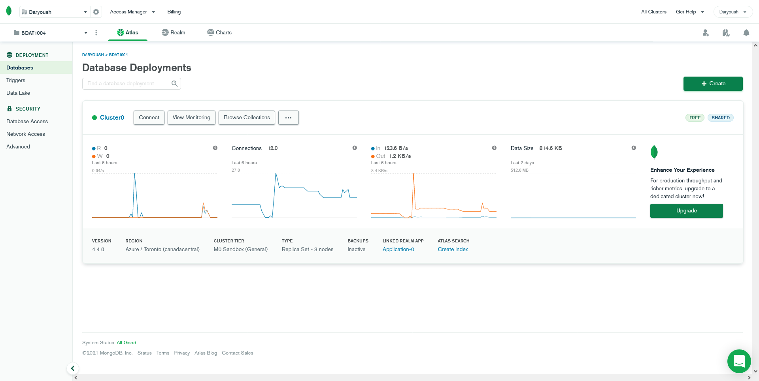
MongoDB Atlas (main dashboard screenshot)
© 2021 BDAT 1004 Final Group Project

Slide 10
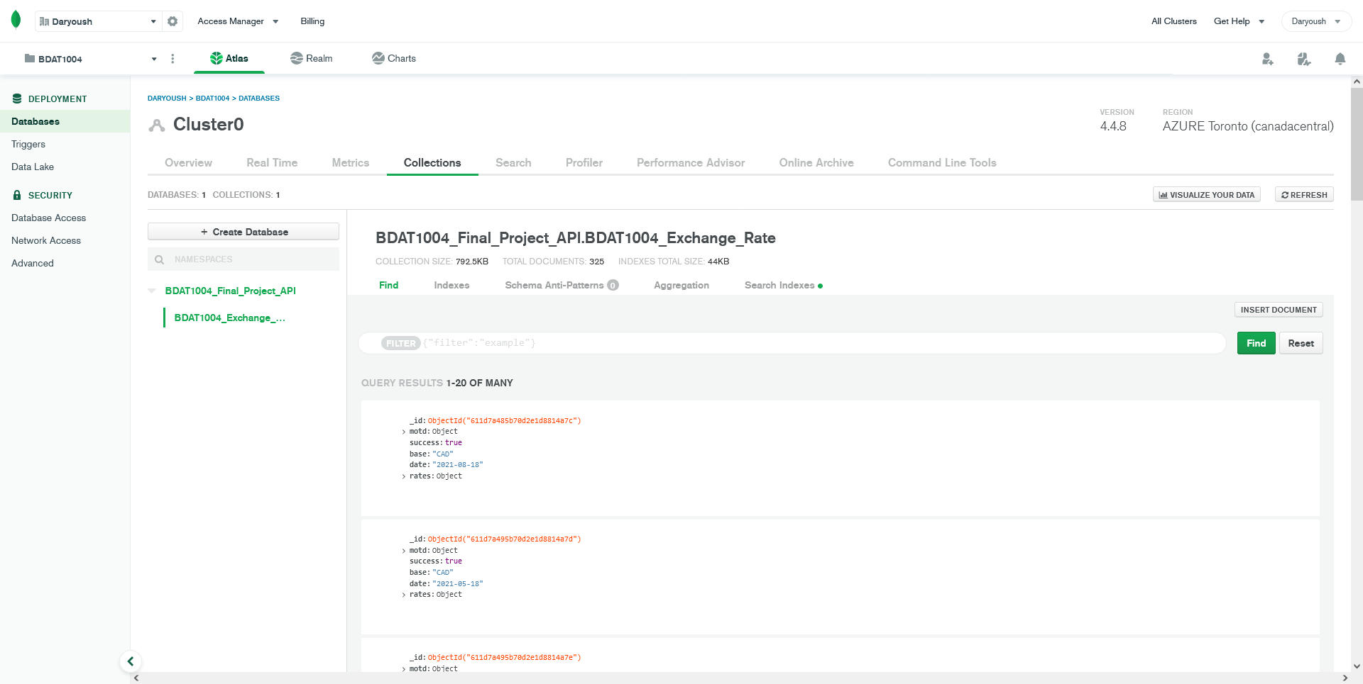
MongoDB Atlas (cluster database screenshot)
© 2021 BDAT 1004 Final Group Project

Slide 11
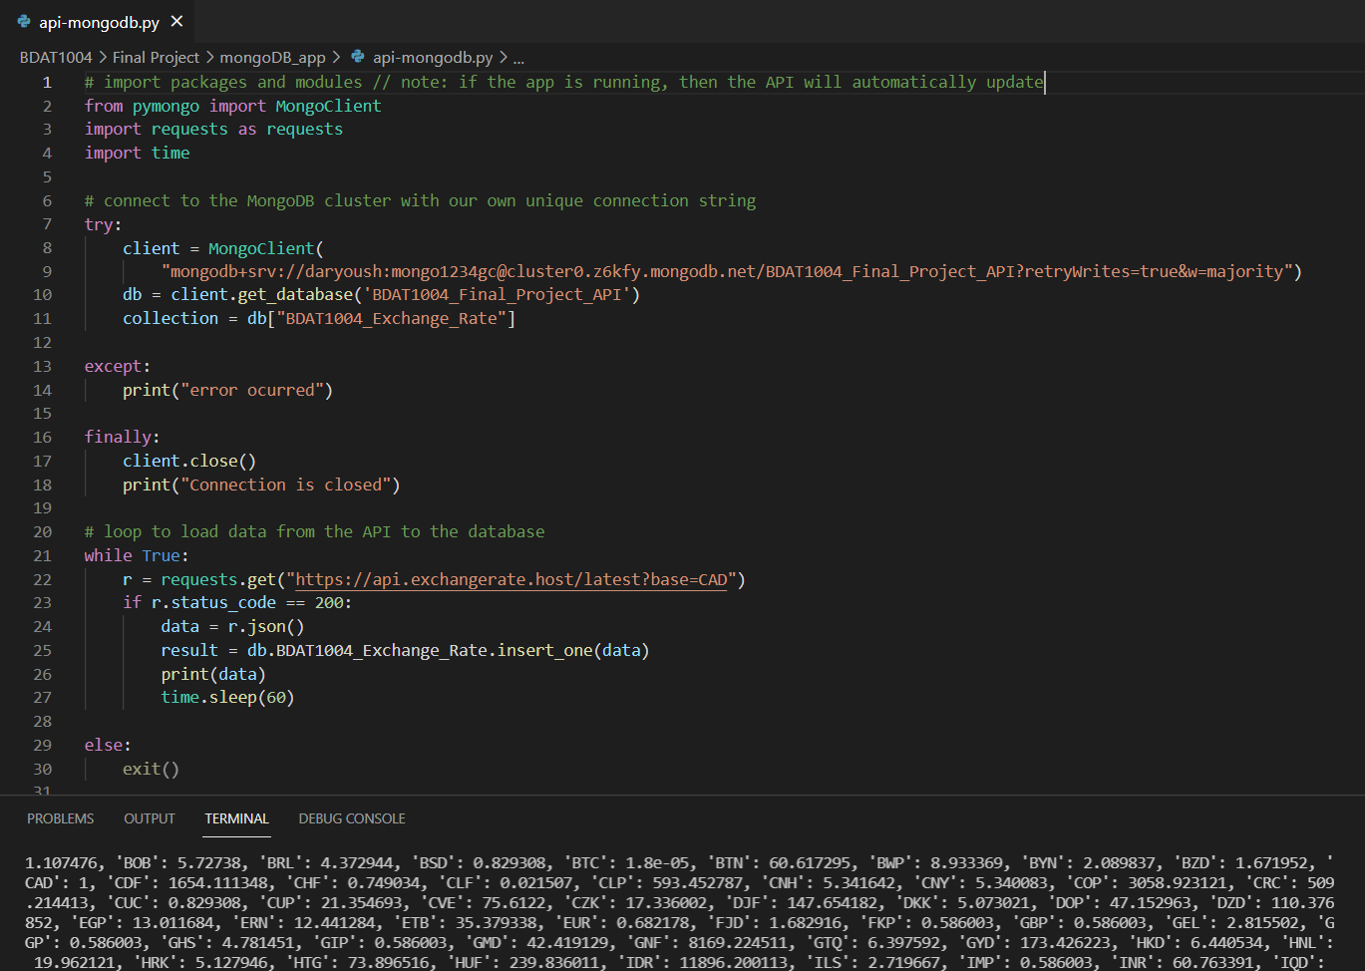
Pymongo code (screenshot)
© 2021 BDAT 1004 Final Group Project

Slide 12


Website Design
We used the Flask framework:
Step #1:
Created a new Flask website and coded HTML/CSS
Step #2:
Designed the website with several pages i.e. “About”, “Team”, etc.
© 2021 BDAT 1004 Final Group Project

Slide 13
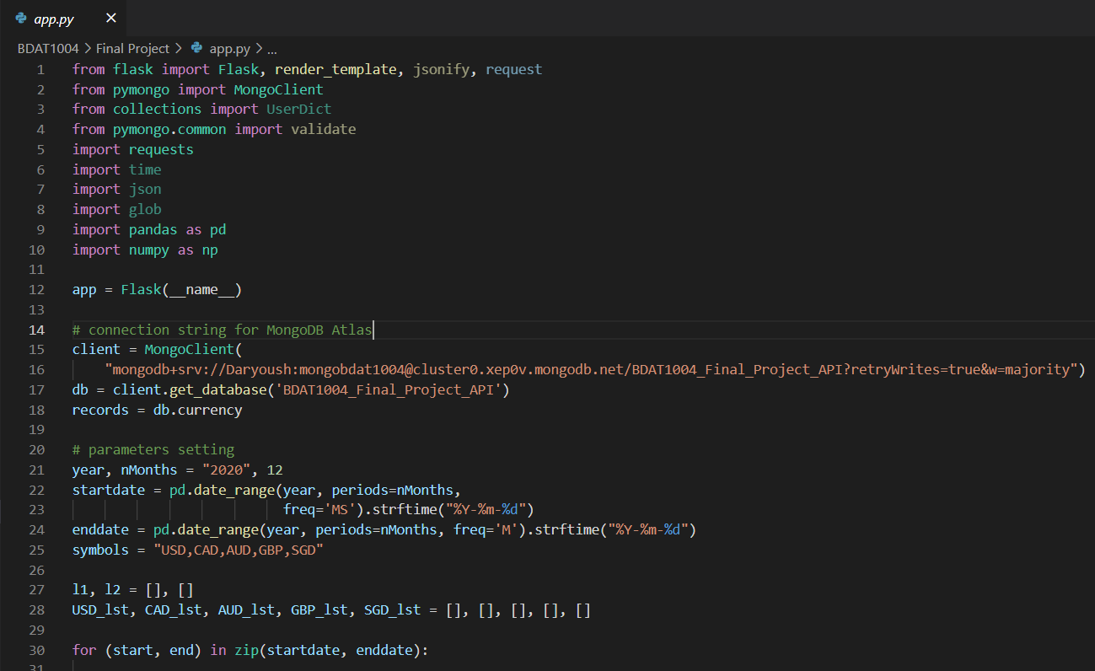
Website Design (Flask code screenshot)
© 2021 BDAT 1004 Final Group Project

Slide 14
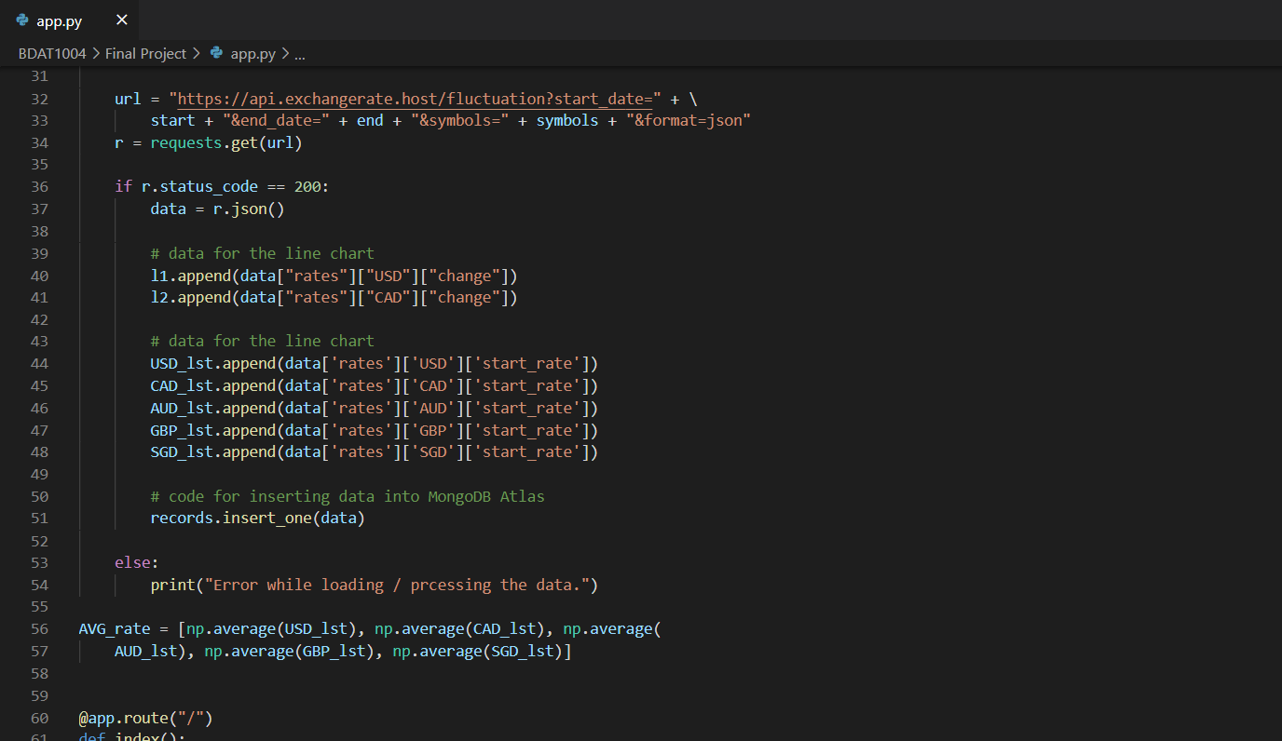
Website Design (Flask code screenshot) - cont
© 2021 BDAT 1004 Final Group Project

Slide 15
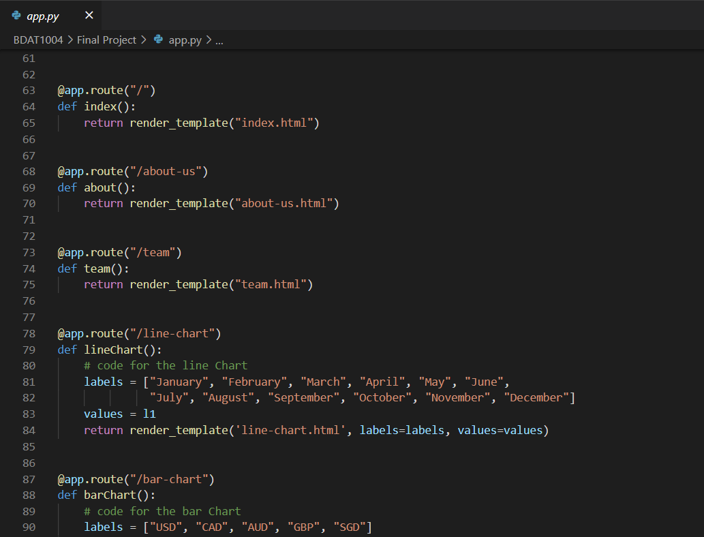
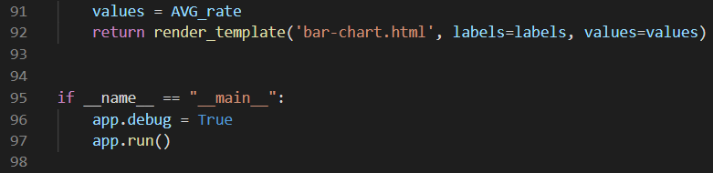
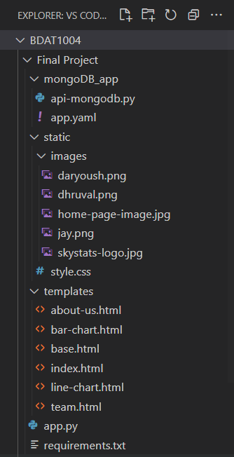
Website Design (Flask code screenshot) - cont
© 2021 BDAT 1004 Final Group Project

Slide 16


Google Cloud Platform
We used Google Cloud Platform:
Step #1:
Created a free GCP project and added our website files
Step #2:
Deployed our Flask website to the GCP App Engine available at https://bdat1004-gp.ue.r.appspot.com
© 2021 BDAT 1004 Final Group Project

Slide 17
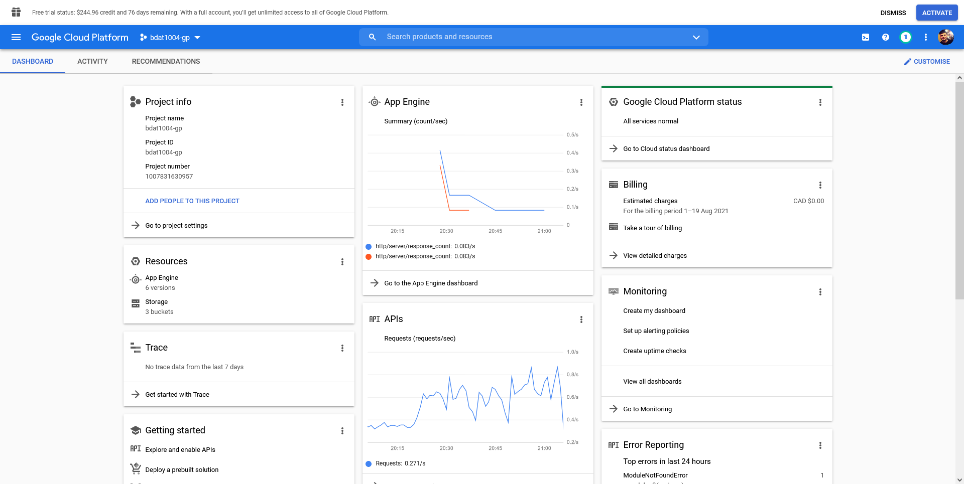
Google Cloud Platform (screenshot)
© 2021 BDAT 1004 Final Group Project

Slide 18
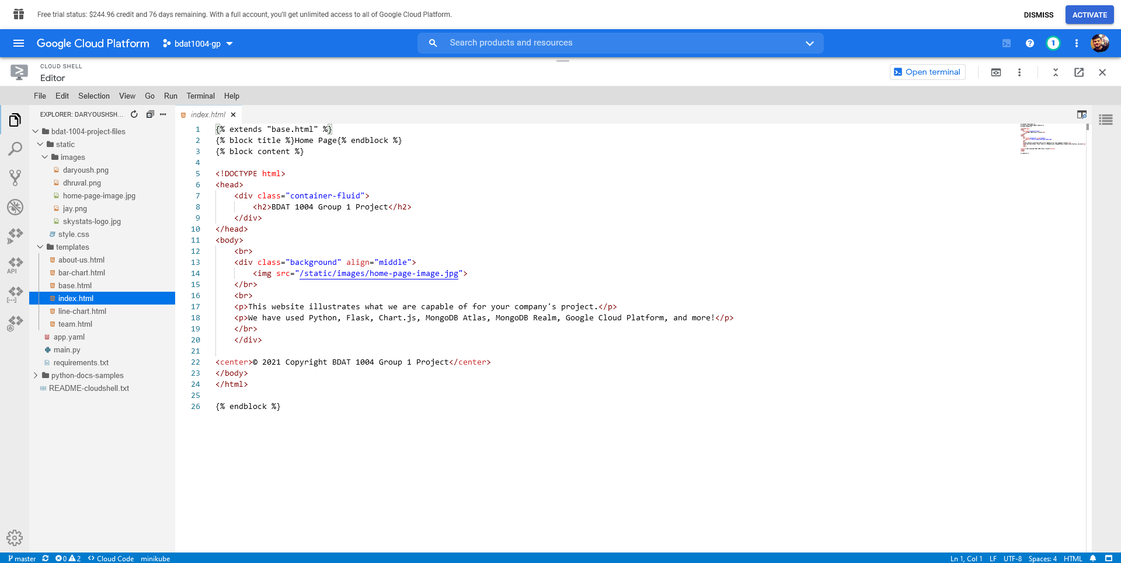
Google Cloud Platform (screenshot) - cont
© 2021 BDAT 1004 Final Group Project

Slide 19
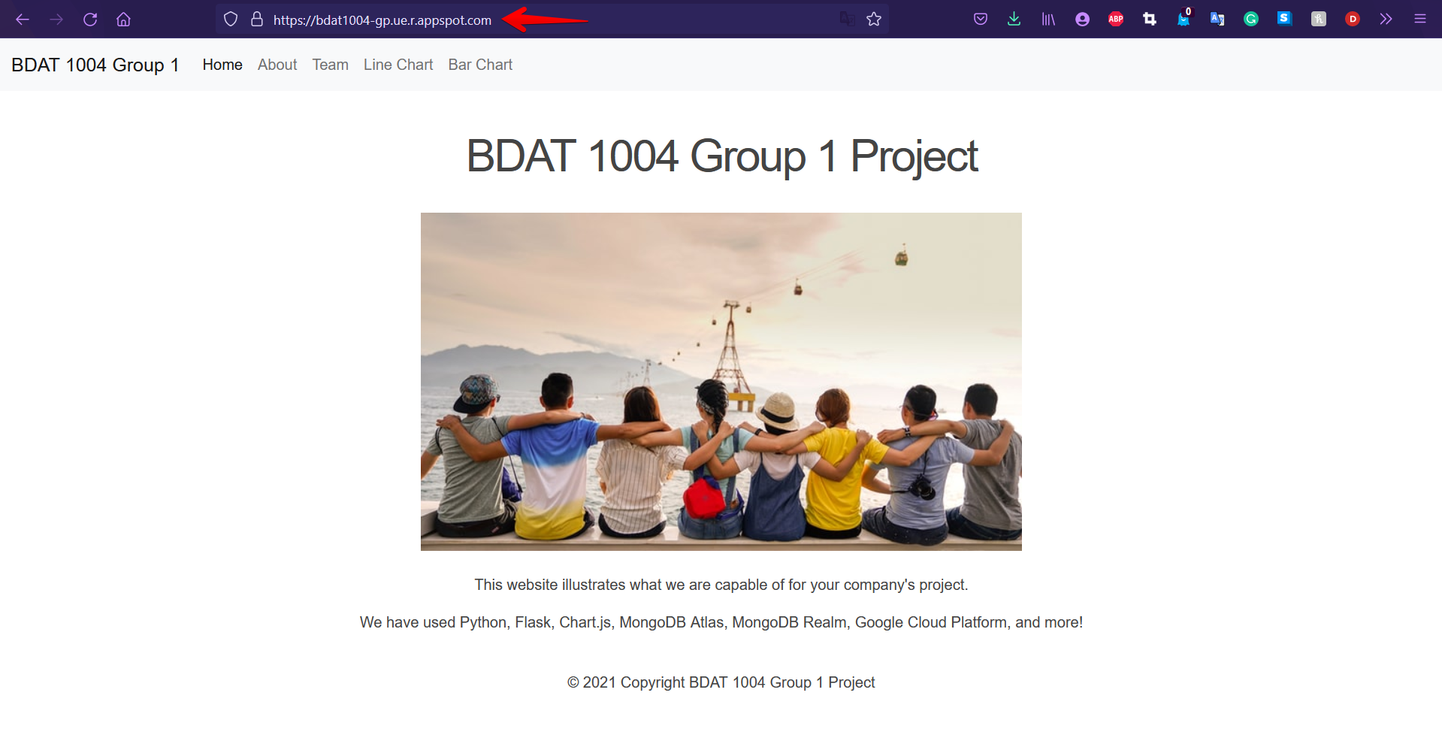
Website URL / Page (screenshot)
© 2021 BDAT 1004 Final Group Project

Slide 20


Chart.js Visualizations
We used Chart.js for our visualizations:
Step #1:
Created a couple charts with the help of the Chart.js library
Step #2:
Uploaded the charts on various pages via site at https://bdat1004-gp.ue.r.appspot.com
© 2021 BDAT 1004 Final Group Project

Slide 21
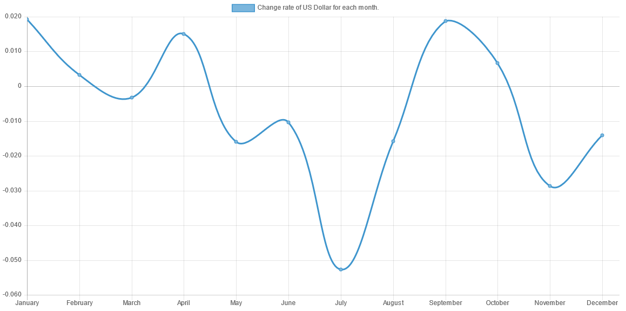
Chart.js (Line chart - screenshot)
© 2021 BDAT 1004 Final Group Project

Slide 22
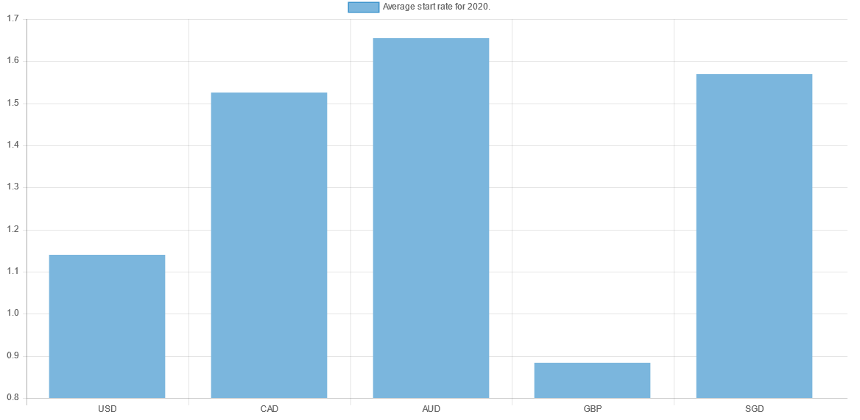
Chart.js (Bar chart - screenshot)
© 2021 BDAT 1004 Final Group Project

Slide 23


Bonus Questions
We used MongoDB Realm:
Step #1:
Created a MongoDB Realm, connected our API to our DB and extracted the data
Step #2:
Used Postman with a POST HTTP request with a secret key parameter to answer the questions
© 2021 BDAT 1004 Final Group Project

Slide 24
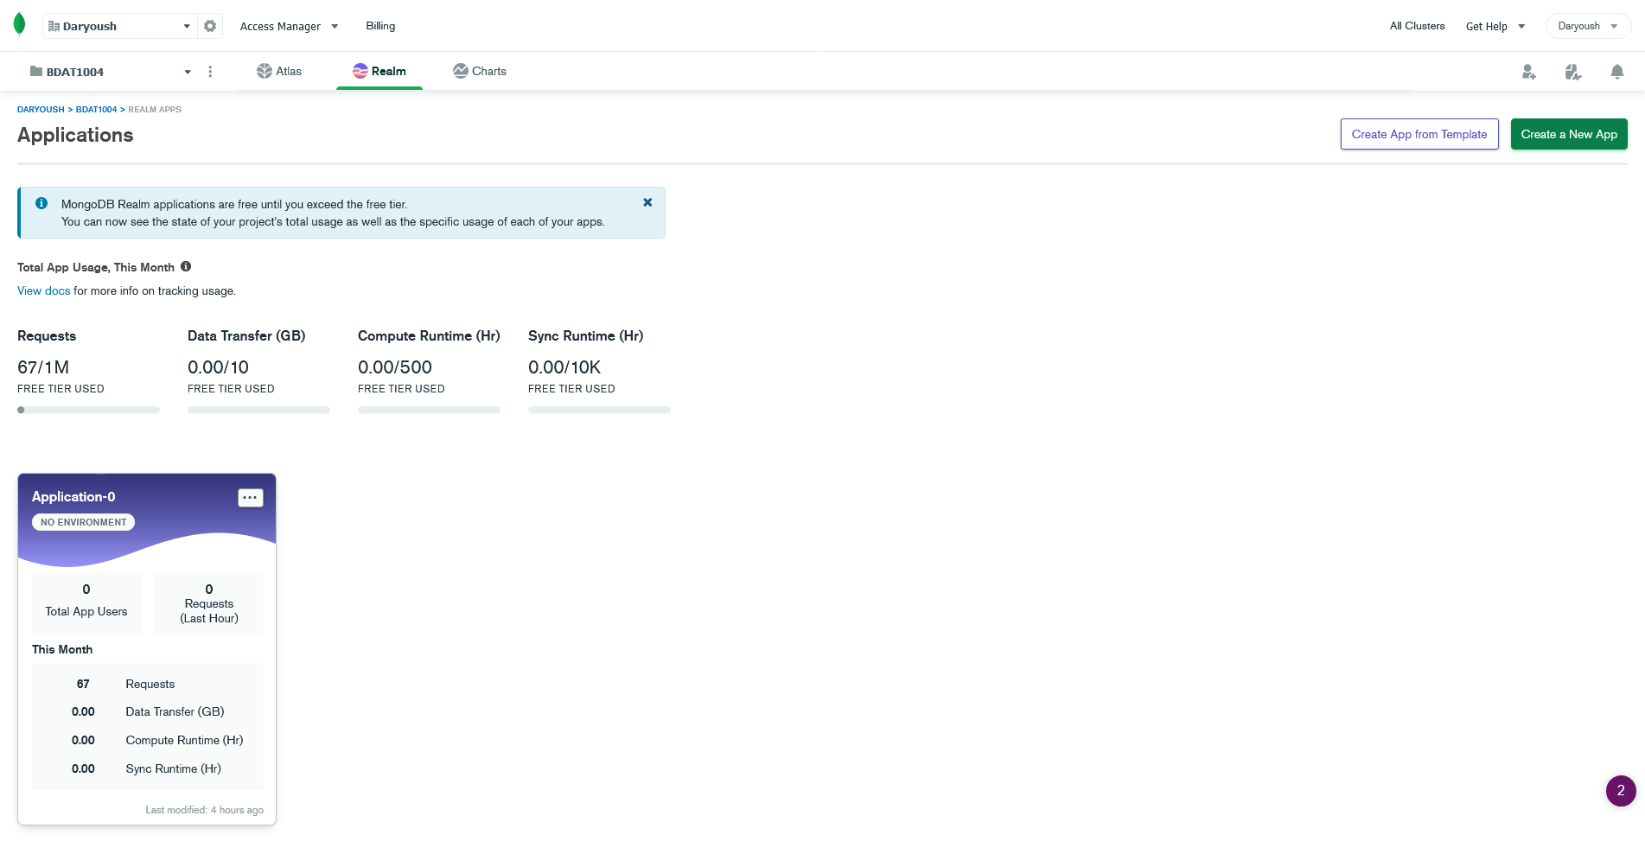
MongoDB Realm (app dashboard screenshot)
© 2021 BDAT 1004 Final Group Project

Slide 25
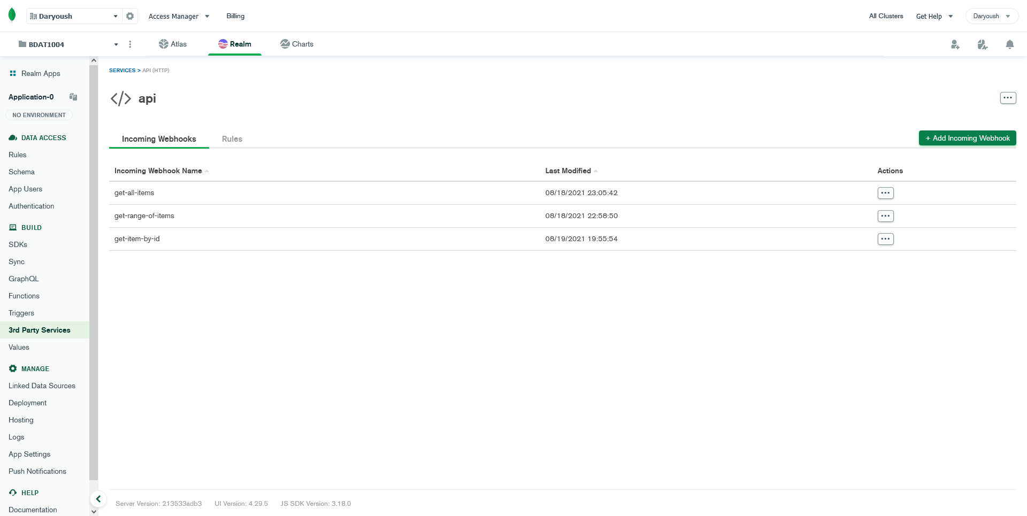
MongoDB Realm (api webhooks screenshot)
© 2021 BDAT 1004 Final Group Project

Slide 26
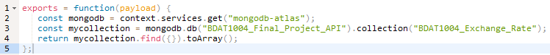
MongoDB Realm (code)
Get all items
URL:
https://webhooks.mongodb-realm.com/api/client/v2.0/app/application-0-mhjet/service/api/incoming_webhook/get-all-items?secret=post1234gc
Code:
Get a range of items
URL:
https://webhooks.mongodb-realm.com/api/client/v2.0/app/application-0-mhjet/service/api/incoming_webhook/get-range-of-items?secret=post1234gc
Code:
© 2021 BDAT 1004 Final Group Project

Slide 27
MongoDB Realm (code) - cont
3. Get item by ID
URL:
https://webhooks.mongodb-realm.com/api/client/v2.0/app/application-0-mhjet/service/api/incoming_webhook/get-item-by-id?secret=post1234gc
Code:
© 2021 BDAT 1004 Final Group Project

Slide 28

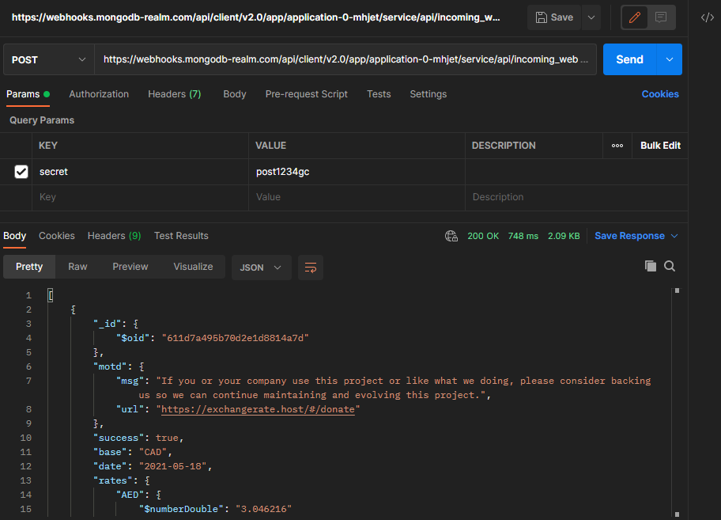
MongoDB Realm (postman POST request)
© 2021 BDAT 1004 Final Group Project

Slide 29

Fit Gap Analysis
• With more time, we can have a better business question.
• Current data set is rather small, more analysis can be done with a bigger data set.
• Better charts with more colours and variety.
• Install pandas onto Google Cloud Platform.
© 2021 BDAT 1004 Final Group Project

Slide 30

© 2021 BDAT 1004 Final Group Project

